Slide 1
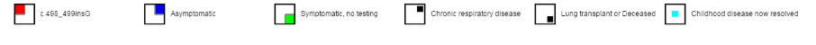
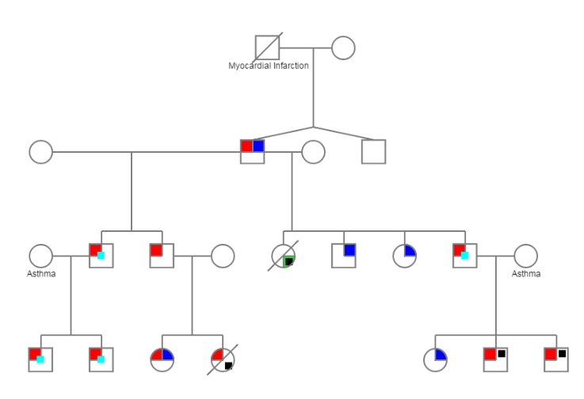
Groups Update: 2-0442 c.498_499 ins G
= included in study
Fam 10
DV-12
2-0422-13
unaffected
2-0422-23
unaffected
Deceased at birth
DV-10
DV-09
2-0422-16
unaffected
2-0422-17
unaffected
2-0422-3
unaffected
2-0422-2
unaffected
Affected, died
in childhood
2-0422-22
Affected, neonatal RDS now stable
2-0422-21
unaffected
DV-11
DV-08
2-0422-14
Affected FTT, resp failure at <1yo
2-0422-15
Affected, resp failure at 3 m, normal chest CT 2005
2-0422-4
unaffected
2-0422
Affected, lung transplant
2-0422-18
Affected, ex 35, ILD early, now “asthma” sympt.
2-0422-19
Affected, ILD/Picu at <1ml, now asthma/exercise sympt
2-0422-?
affected

Slide 2
I73T pedigree – child as index case
5-012 family (WU)
Family 07 (Chi)
I73T
asymptomatic
65 yrs
symptomatic
5-012-1
lung transplant
DV-03
DV-04
40 yrs
5-012-3
5-012-2
DV-06
DV-05
14 yrs
5-012-4
5-012
5-012-5
8yrs
DV02

Slide 3
I73T pedigree –
NW-Chi-12 family
I73T
asymptomatic
symptomatic
12-5
lung transplant
12-8 (???aunt or great aunt???
DV-15
40 yrs
12-3
12-2
DV-14
DV-13
12 - proband

Slide 4
I73T pedigree –
NW-Chi-14 family
I73T
asymptomatic
symptomatic
lung transplant
?
?
DV-18
?? yrs
14-3
14-2
DV-17
DV-16
14 - proband

Slide 5
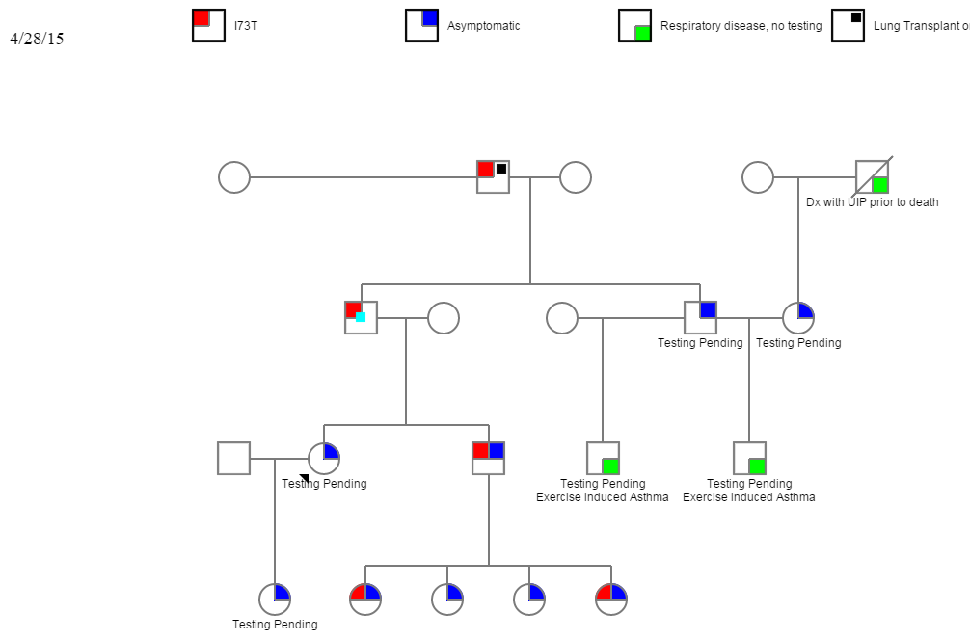

7-0074 Family: I73T
We don’t have
3-17-21 (IPF family)

